Slide 1
COMP1206 Topic 3 Multi-threading
Andy Gravell
March 2020

Slide 2
Objectives
this lecture focuses on multi-threading
what it is and why you need to use it
why it can be risky or dangerous
how to code safer multi-threading
in general, and in JavaFX in particular
multi-threaded applications are now common
so professional programmers need to know how to code them
and the many potential and real pitfalls
Java threading is difficult because it is not particularly portable
one area where WORA often fails, so extra care is needed

Slide 3
Multi-tasking and Multi-threading
We are used to running multiple applications on our PCs
and likewise multiple apps on our smartphones
this is called multi-tasking: task = process = running app(lication)
The operating system organises switching between tasks
even if there is only one processor, app(lication)s share time on this
so they execute concurrently, or at least they appear to do so
An application task may divide into multiple threads
each thread executes concurrently, or at least they appear to do so
the difference is that threads cooperate, so they share memory
all threads in one app(lication) can read and write its objects in its heap

Slide 4
Reasons for Multi-threading
Multi-threaded programming is common these days
which is why we moved this topic into the first year
GUI applications are usually multi-threaded
one thread to respond to user input and provide visual feedback
other threads can work only long running computations in the background
Accessing the network is also unpredictable and may be slow
so a web browser must use a separate thread for loading HTML pages
In a simulation, it is natural to provide one thread per entity
Finally, PCs often have multi-core CPUs
you need at least one thread per CPU to keep each of them busy

Slide 5
Risks of Multi-Threading
Threads share the heap, method area, and constant pool
each has its own stack, so local variables and arguments are not shared
If multiple threads access a shared object in the heap
the outcome may be unexpected
race conditions, lost updates, update anomalies / corrupted data
the following slides will explain these terms
Such bugs are difficult to find
as they may not happen every time the program runs
the execution sequence and results are typically non-deterministic
which will also be covered in the following slides

Slide 6
The Effect of Errors
If there is an error in
your programming assignment: you lose marks ☹
a computer game: you can reboot, reload it & carry on playing ☺
a business application: the business could lose money, and may fail
software controlling a machine: someone could be injured or die
So I want to make sure you know about the Therac-25 incident
you can read more through the Wikipedia article
the slides here are constructed using quotes from that article

Slide 7
Therac-25 Background
The Therac-25 was a computer-controlled radiation therapy machine produced by Atomic Energy of Canada Limited (AECL) in 1982
Because of concurrent programming errors, it sometimes gave its patients radiation doses that were hundreds of times greater than normal, resulting in death or serious injury
A commission concluded that the primary reason should be attributed to the bad software design and development practices, and not explicitly to several coding errors that were found
In particular, the software was designed so that it was realistically impossible to test it in a clean automated way

Slide 8
Therac-25 Further Details
The six documented accidents occurred when the high-current electron beam generated in X-ray mode was delivered directly to patients
Previous models had hardware interlocks to prevent such faults, but the Therac-25 had removed them, depending instead on software checks for safety
The equipment control task did not properly synchronize with the operator interface task, so that race conditions occurred if the operator changed the setup too quickly
…

Slide 9
Lessons
Ensure your software can be tested
particularly any business- or safety-critical code
avoid concurrency features that can give non-deterministic results
take extra care if you have to code your own synchronisation mechanism
If coding in Java then you should adopt the following strategies
confinement (thread local data): each object is used by just one thread
objects from immutable classes are safe as they never change
use thread safe methods from standard libraries for mutable shared objects
for example, java.util.concurrent and javafx.concurrent
synchronise any of your own methods acting on a shared object
and avoid deadlock by not calling one such method from another
don’t rely on lower level mechanisms such as manual locks, thread priorities

Slide 10
Creating and Starting a Thread
class MyThread extends Thread {
public void run() {
System.out.println(“I’m a thread!");
}
}
public class MyProg {
public static void main(String args[]) {
Thread t = new MyThread();
t1.start(); // causes t to run()
}
}
class MyRun implements Runnable {
public void run() {
System.out.println(“I’m a thread!");
}
}
public class MyProg {
public static void main(String args[]) {
New Thread(New MyRun()).start();
// also creates and runs a new thread
}
}
Starting the thread is how you tell the JVM to create the stack on which its code will run

Slide 11
Non-Determinism
There are two threads here, one executing main(), the other run()
Imagine these methods loop forever printing “main” and “run”
What output do you expect to see?
The answer could be lines of “main”, or lines of “run”, or a mixture
Java does not define how threads should share execution time
this depends on the operating system and the CPU itself
You can try using t.setPriority(p), t.yield(), or t.sleep(m)
But the effect of these methods is also not fully defined
WORA is not a lot of good to you here

Slide 12
Race Conditions
Now imagine two threads, both assigning to x, which is currently 1
One is about to execute x = x + 2;
The other is about to execute x = x * 3;
What do you think the final value of x will be?
The answer is not determined by Java
if the first assignment above executes first, the answer will be 9
if the second assignment executes first, the answer will be 5
This is an example of a race condition
the result of the program is non-deterministic, so it cannot be tested

Slide 13
Lost Updates
In fact, there are even more possibilities
Each assignment can involve making a local copy of x
then performing the arithmetic on this, and finally writing the result back
this is how the JVM performs its stack-based calculations, for example
If so, a sequence such as the following could occur
xCopy1 = x;
xCopy2 = x;
x = xCopy1 + 2
x = xCopy2 * 3;
In this case, one of the updates to x is said to be lost
and the final value the variable will then be 3

Slide 14
Data Corruption
If there are multiple CPUs, or multiple cores, things get even worse
The two threads may truly execute concurrently
not just by time-switching between their instructions
So they could write simultaneously to the same memory cell
and the result of this is typically not defined by the hardware
meaning any final value is possible
for example, an interleaving of the different bit patterns
The end result is therefore corrupted data
impossible to explain, and therefore almost impossible to debug
You must avoid this situation using one of the 5 strategies above

Slide 15
Reminder of the 5 Strategies
confinement, also known as thread local data
each object is used by just one thread
objects from immutable classes are safe as they never change
use thread safe methods for updates to mutable shared objects
for example, methods from java.util.concurrent and javafx.concurrent
synchronise any of your own methods acting on a shared object
and avoid deadlock by not calling one such method from another
don’t rely on lower level mechanisms
avoid, for example, manual locking, volatile variables, thread priorities

Slide 16
Safe Multi-Threading via Synchronisation
To synchronise means to agree with someone else what time it is
If two methods m() and n() are synchronised on the same object
Java guarantees they do not run concurrently
instead, either m() executes and then n(), or n() executes and then m()
they run in sequence, so that their execution is serialised
A classic situation is updating your bank balance
transactions must be serialised to avoid anomalies and corruption
You can use this approach to code safe multi-threading
avoiding lost updates and other update anomalies
there is some loss of concurrency, however
so don’t synchronise more code than you need to

Slide 17
Synchronising Code and Methods
Synchronised code must obtain the object’s lock before it can execute
you can synchronise any block of code using a synchronisation block
synchronized (obj) { code }
you can declare a whole method to be synchronized, on the this object
synchronized Point getX() { method_body }
Synchronised code must obtain the object’s lock before it can execute
If another thread tries to synchronise on the same object, it must wait
When the synchronised code completes, the lock is released
one of the waiting threads will then acquire the lock so that it can continue

Slide 18
Good Synchronisation Practices
Synchronise access to shared variables in multithreaded programs
This provides mutually exclusive access
and guarantees that any writes (aka updates) are visible to other threads
Good practices include
always lock during updates to an object's shared fields
always lock during access of possibly updated fields
never lock when invoking methods on other objects
Lock carry a runtime cost
so you should use them as little as possible
threads are intended to boost performance by running code in parallel

Slide 19
Additional Comments on Locking
A cycle of lock requests can cause deadlock
To avoid this always use the same order when requesting locks
for example A, B, C, D, or A, C, E, but not B, A, nor A, C, D, B
This heuristic is easy when it is your code making these requests
But sometimes library code includes the required synchronisation
the methods are said to be thread safe
this means they can be called from any thread
and hopefully there will be no deadlock ☺
But sometimes the library methods are not thread safe
so it is your responsibility to add synchronisation to your own code

Slide 20
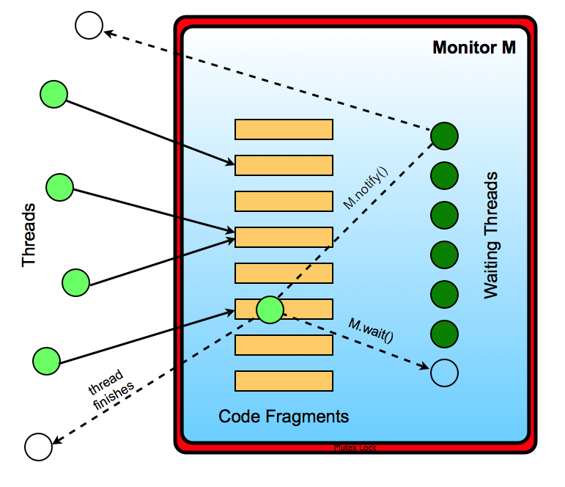
Monitors
A general solution
Due to Hoare & Brinch Hansen
A thread waits for access
And may proceed when notified
Any object obj in Java supports
obj.wait()
obj.notify()

Slide 21
Monitor Controlled Method Ordering
Synchronised code is run by at most one thread at the same time
for example o.m() followed by o.n(), or o.n() and then o.m()
but this does not guarantee which method comes first (ie happens before)
Java has monitor controlled access to any object o
o.wait(), o.notify(), and o.notifyAll()
These methods must be used with care
o.notify() only wakes up one thread, and selection of this is arbitrary
if no thread is waiting, o.notify() returns immediately
this can create a race condition & deadlock if o.wait() occurs after o.notify()
o.notifyAll() wakes up all threads, which is safe, but costly and wasteful
Monitors can be used to build higher level mechanisms
prefer higher level ones where available – fewer bugs and less code to write

Slide 22
Threading and JavaFX
JavaFX has its own thread for running events and graphics code
the JavaFX Application thread
This ensures that updates to graphics objects, eg the screen, are safe
such calls occur when you show() a stage or play() a timeline
so you do not need to create your own threads for JavaFX animations
JavaFX background tasks can display and update progress bars
using bind(task.progressProperty()) and updateProgress(i, max)
To invoke other JavaFX methods on the Application thread you call
invokeLater(Runnable task), or invokeAndWait(Runnable task)
these queue up events that invoke the Runnable task when de-queued

Slide 23
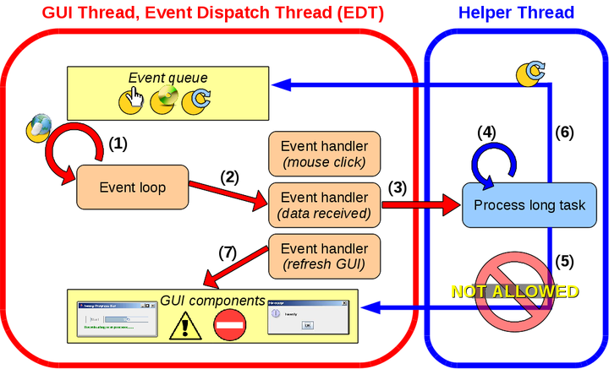
Parallel and Reconfigurable Computing Lab, The University of Auckland

Slide 24
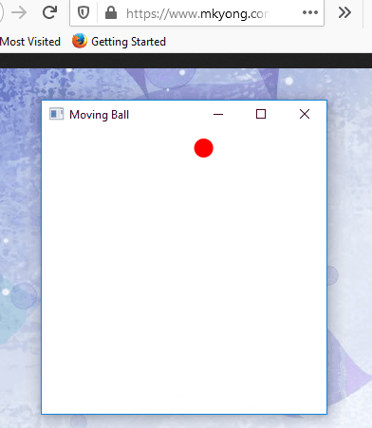
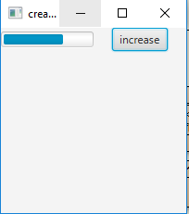
JavaFX
Animation and Progress Bar Tutorials
Sources: mykong.com, geeks for geeks

Slide 25
About java.util.concurrent
We have seen how to update the fields of one object safely
synchronise on the object itself, or using local locks (in a consistent order)
The java.util.concurrent package provides thread-safe collections
the BlockingQueue<E> interface
with array, linked list, and priority queue implementations
and the ConcurrentHashMap<K, V> class
compatible with the Hashtable class , but thread-safe
this package also provides thread pools and futures
which can be used for computationally intensive background processing
The concurrency package also supports Worker threads
these threads are pooled; they can (safely) return one result via a Future<T> and call to get(), or several results via a publish/process List<T>

Slide 26
Accessing concurrent collections
Concurrent collections have standard methods to access them
but they also provide methods with different behaviour
Blocking queues can wait to store/retrieve if the queue is full/empty
Each method can 1) throw an exception 2) return a special value, 3) block / wait indefinitely, or 4) wait for up to a specified time limit:
 | Throws | Special | Block | Times out
Insert | add(e) | offer(e) | put(e) | offer(e, t, u)
Remove | remove() | poll() | take() | poll(t, u)
Examine | element() | peek() | n/a | n/a

Slide 27
An Application Design
Consider a traffic map updated from a network of traffic sensors
There are frequent updates, over a slow network connection
A thread pool can be used to download the new data
but without overloading the system if there are many updates at one time
The traffic state can be stored in a concurrent hash map
Updates to the traffic display can be queued to the display system
invoking later calls to JavaFX methods as required
could optimise this by merging update requests that occur close together
Use worker threads and java.util.concurrent for safe threading
rather than implementing your own lower level concurrency mechanisms

Slide 28
Further Reading
Why thread priorities are unreliable:
https://stackoverflow.com/questions/12038592/java-thread-priority-has-no-effect
Safe threading:
https://dzone.com/articles/7-techniques-for-thread-safe-classes
http://web.mit.edu/6.005/www/fa14/classes/18-thread-safety/
Concurrency in JavaFX 2:
https://examples.javacodegeeks.com/desktop-java/javafx/javafx-concurrency-example/
https://docs.oracle.com/javafx/2/threads/jfxpub-threads.htm
Animation in JavaFX 2 does not need threading:
https://www.mkyong.com/javafx/javafx-animated-ball-example/
Tutorial on JavaFX progress bars:
https://www.geeksforgeeks.org/javafx-progressbar/

